Slide 1



Atmospheric Particle Collection and Characterization Using SEM and EDS
Pima Community College -West Particles Team
John Langenbach
Lyra Troy
Alex Chaffon

Slide 2
Fall Semester 2015
Experiment Overview
Particle collection
Exploring particle composition vs altitude
Evidence of stratospheric aerosol layer

Slide 3
Fall Semester 2015
Material Selection
Candidate materials included duct tape, HVAC filter, filter paper
Duct tape - unpredictable in low temperatures
HVAC filter - difficult to analyze with SEM
Filter paper - low cost, easy to analyze

Slide 4
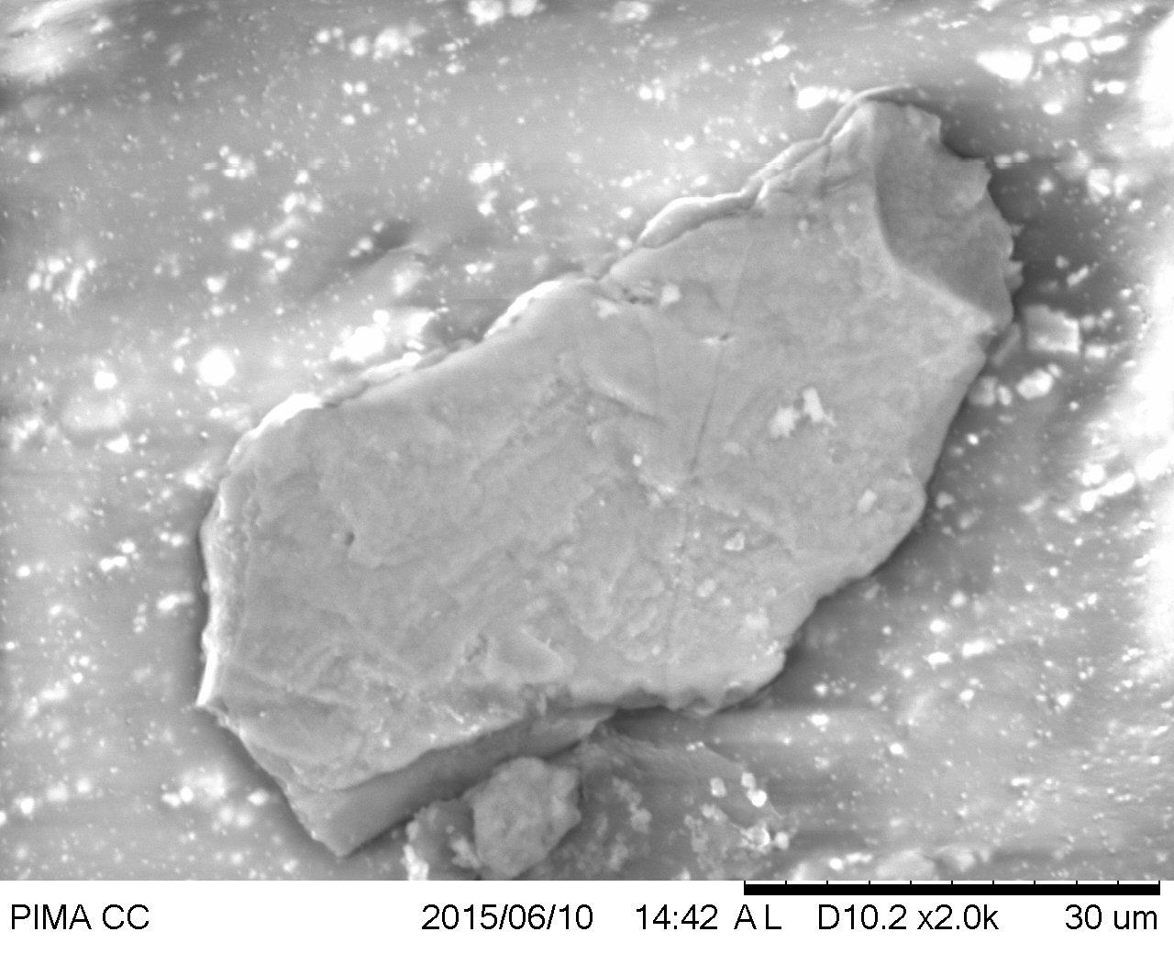
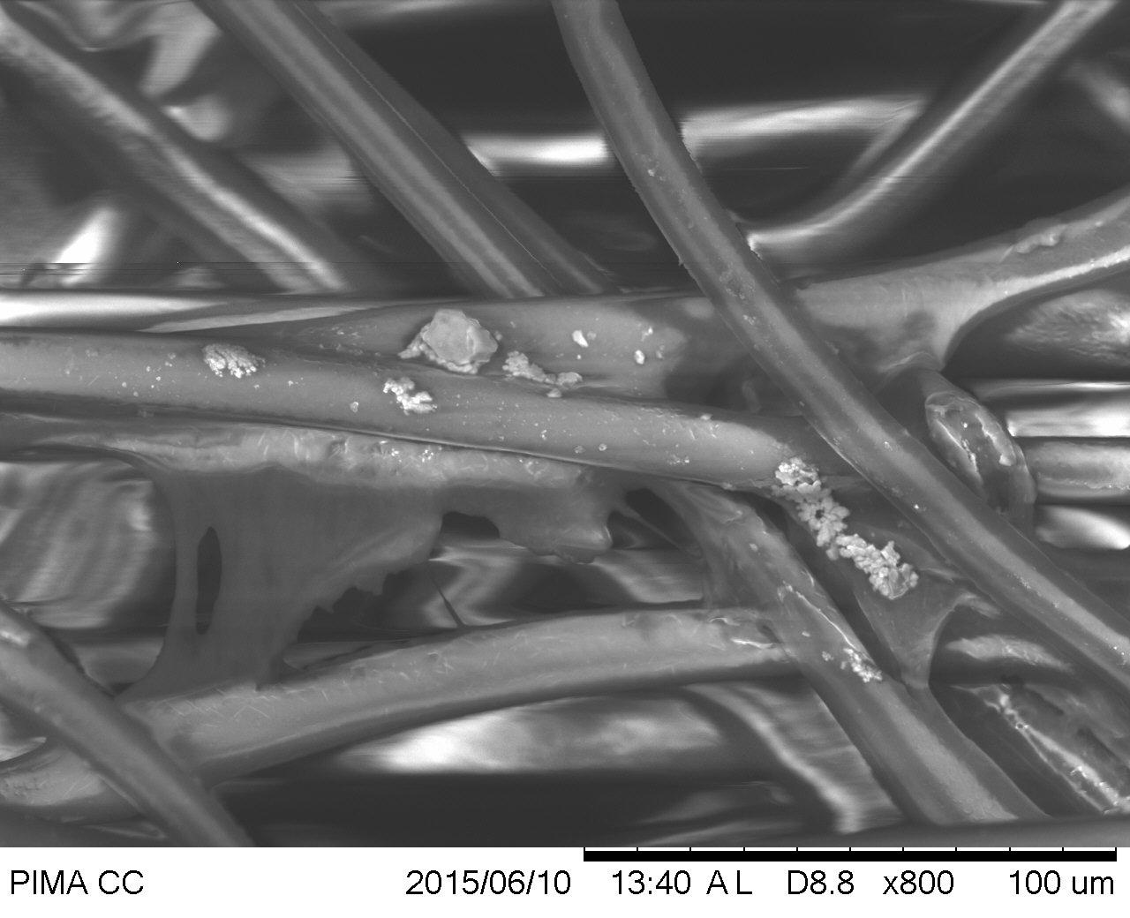
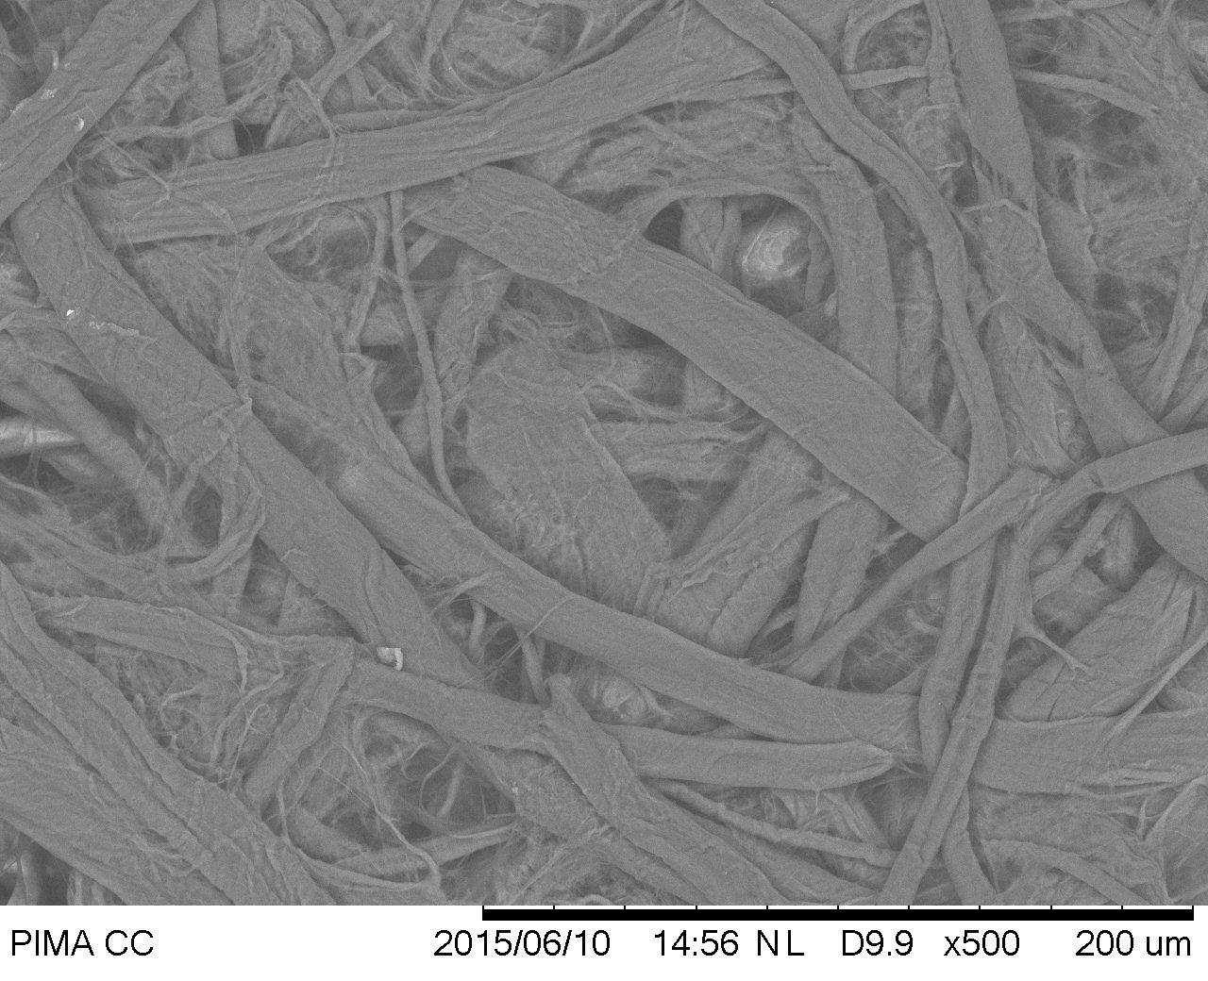
Fall Semester 2015

Slide 5
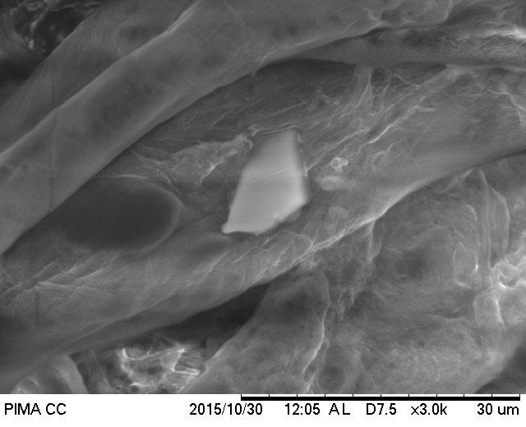
Fall Semester 2015
Field Tests
Initially tested filter paper ascending Mt. Lemmon
No discernable difference of particle composition

Slide 6
Fall Semester 2015
Results
Higher metal content in lower altitude
Sulfur present in highest altitude suggests evidence of stratospheric aerosol layer

Slide 7
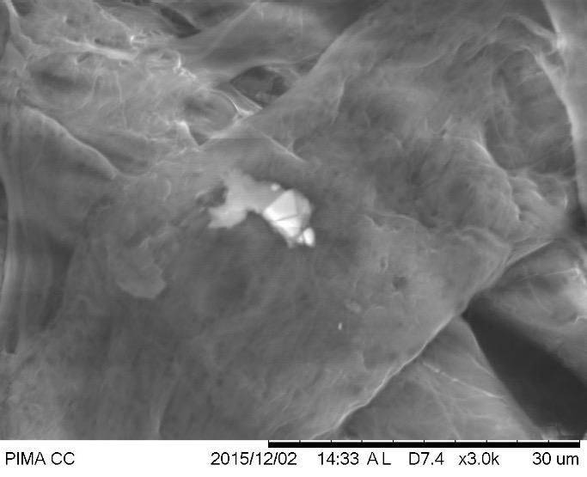
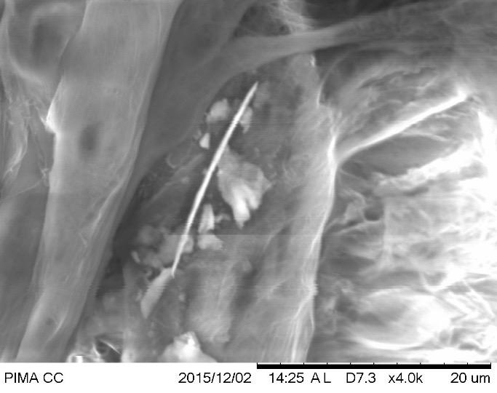
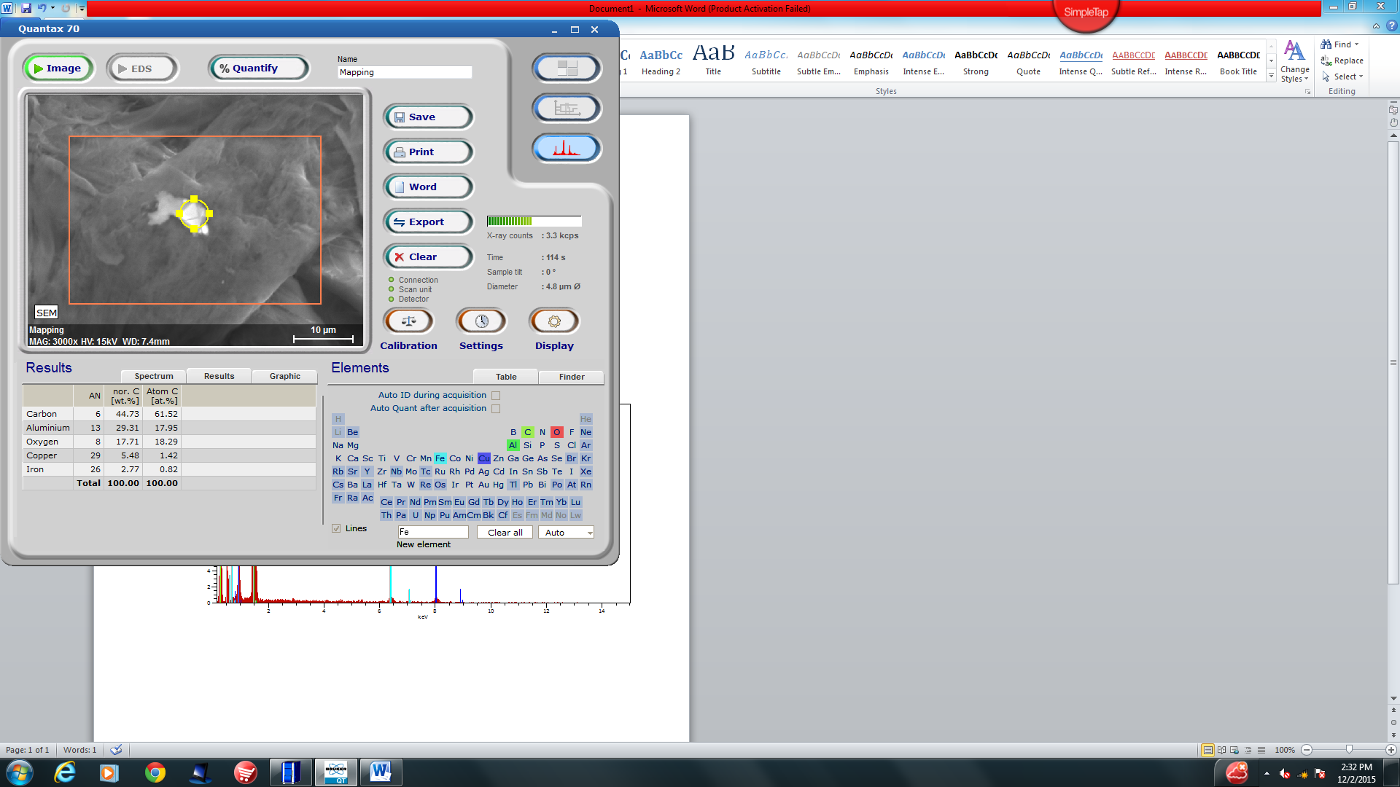
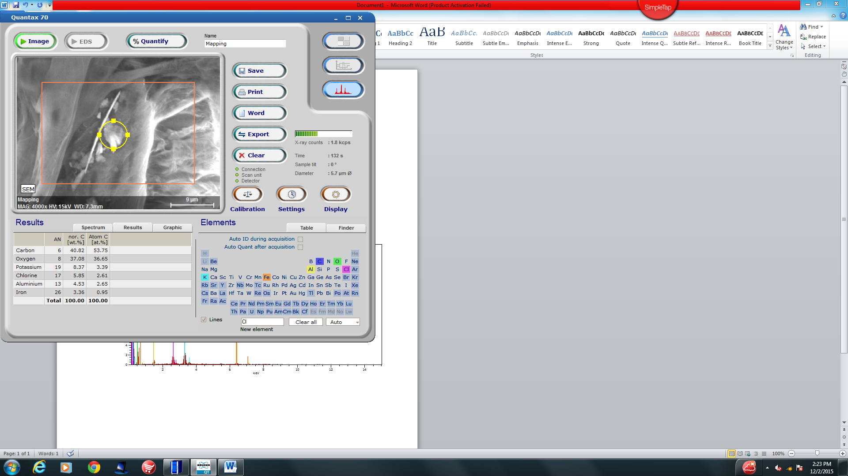
Increment 1 (1,500-19,500ft)

Slide 8
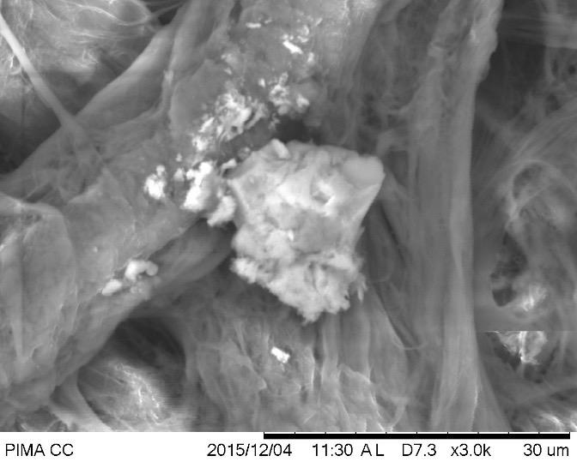
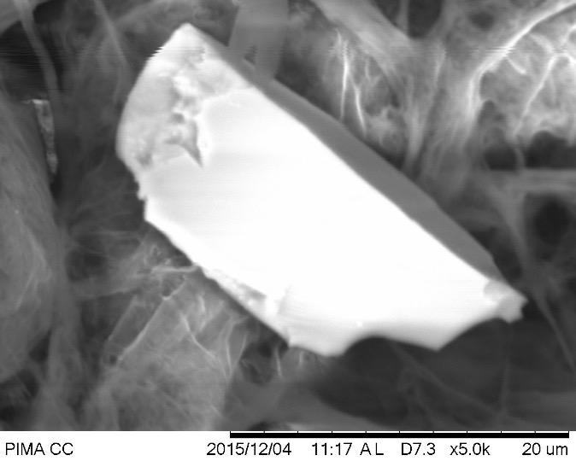
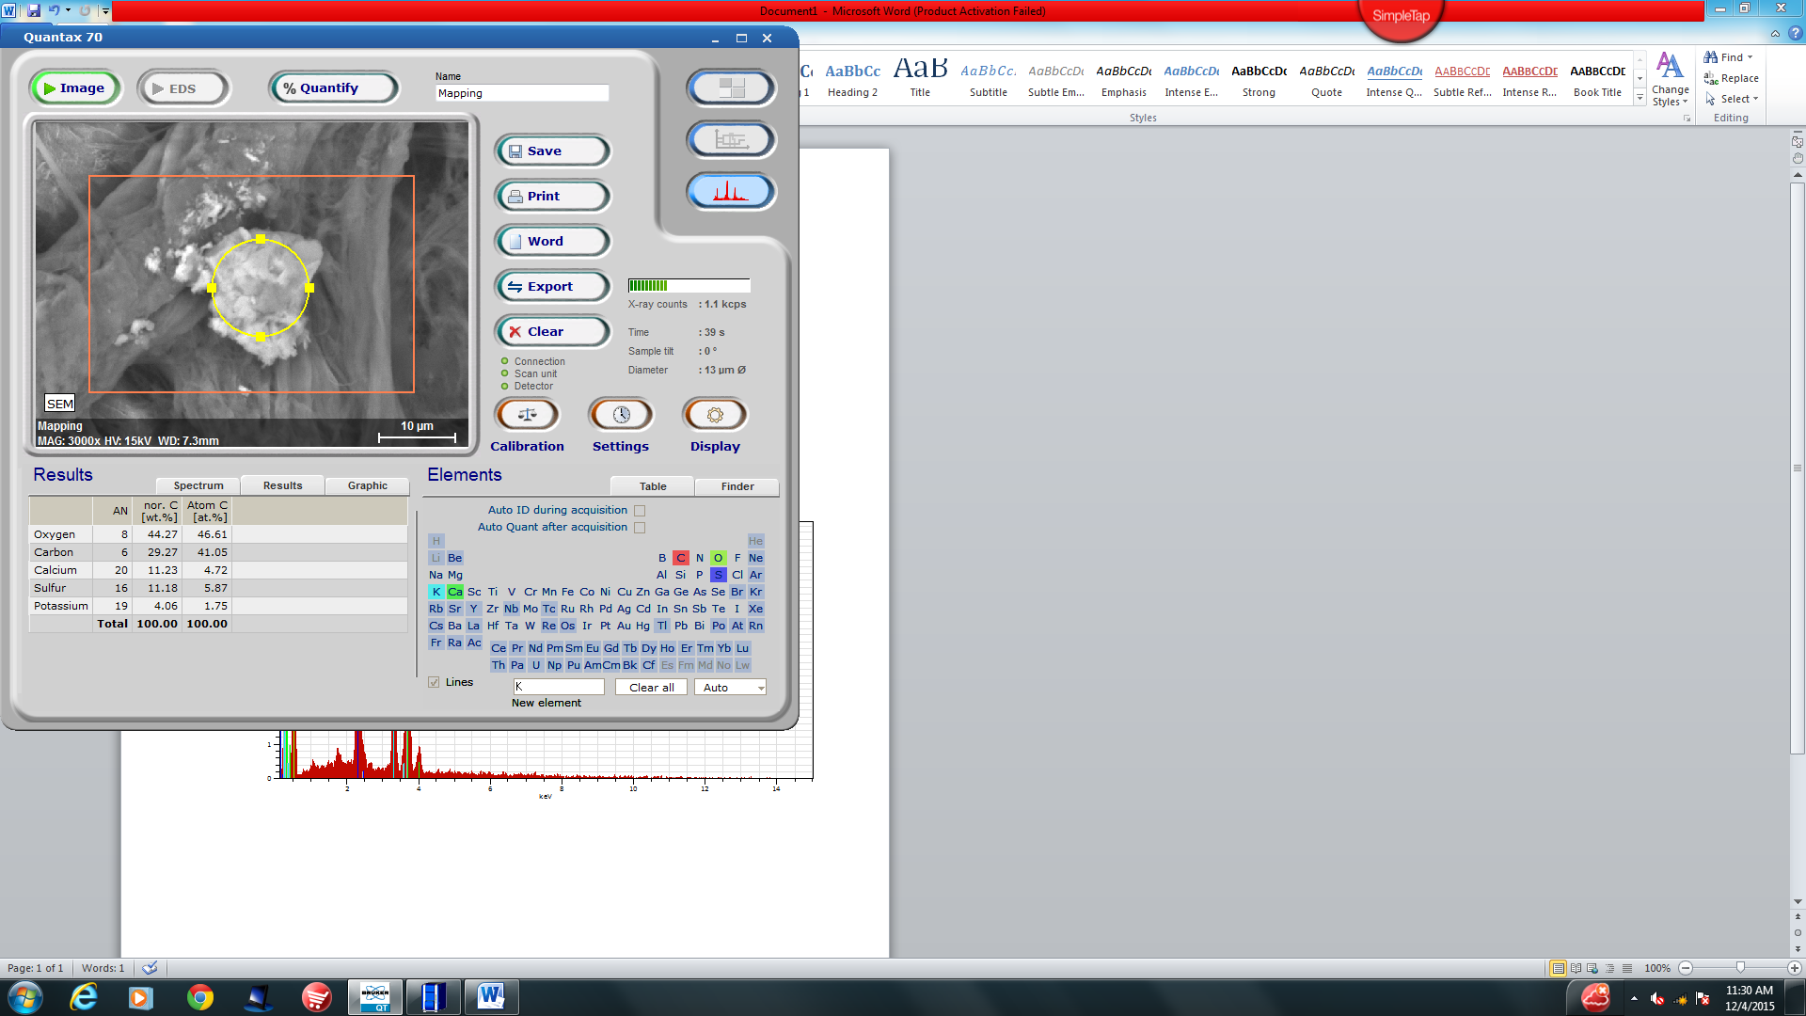
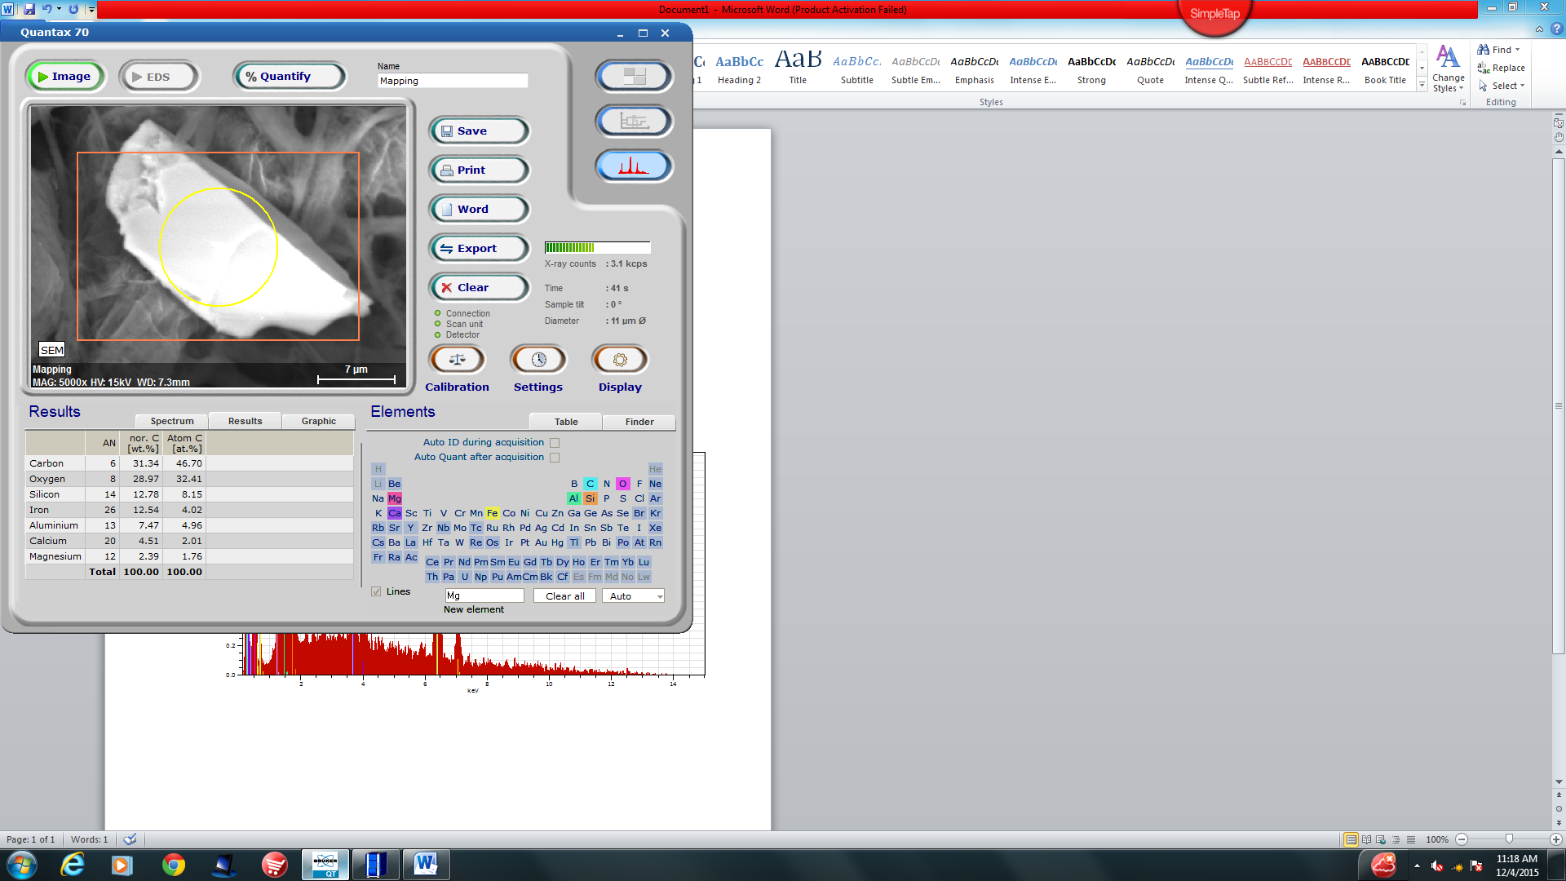
Increment 4 (55,000-73,500ft)

Slide 9
Spring Semester 2016
Experiment Overview
Reproduce Fall Semester experiment using synthesized xerogel

Slide 10
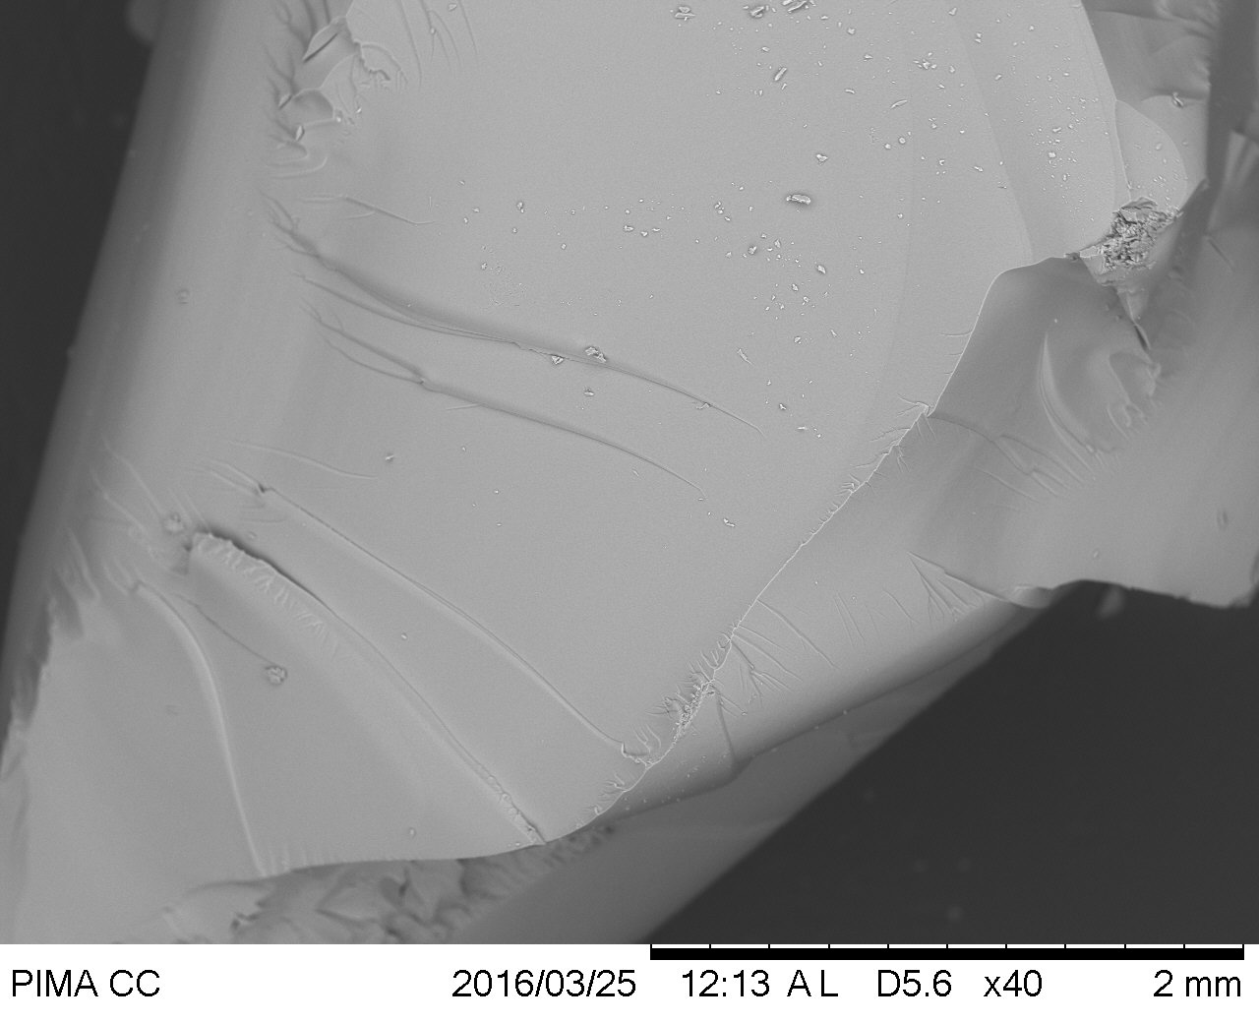
Spring Semester 2016
Xerogel Synthesis
What is xerogel?- Low density high porosity solid structure formed from the dehydration of a gel. Similar to aerogel but uses ambient pressure drying instead of supercritical drying.
Method- Tetramethyl orthosilicate precursor, add methanol, add catalyst solution, soak sol-gel in methanol, dry at 70*C

Slide 11
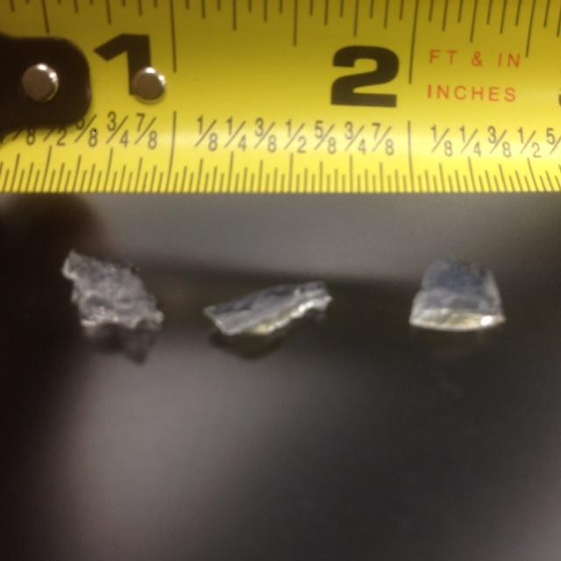
Spring Semester 2016
Xerogel Properties
Density - 0.448g/ cm³
Size - Irregular monoliths on the scale of 10^-3 m diameter
Color - Transparent with blue hue

Slide 12
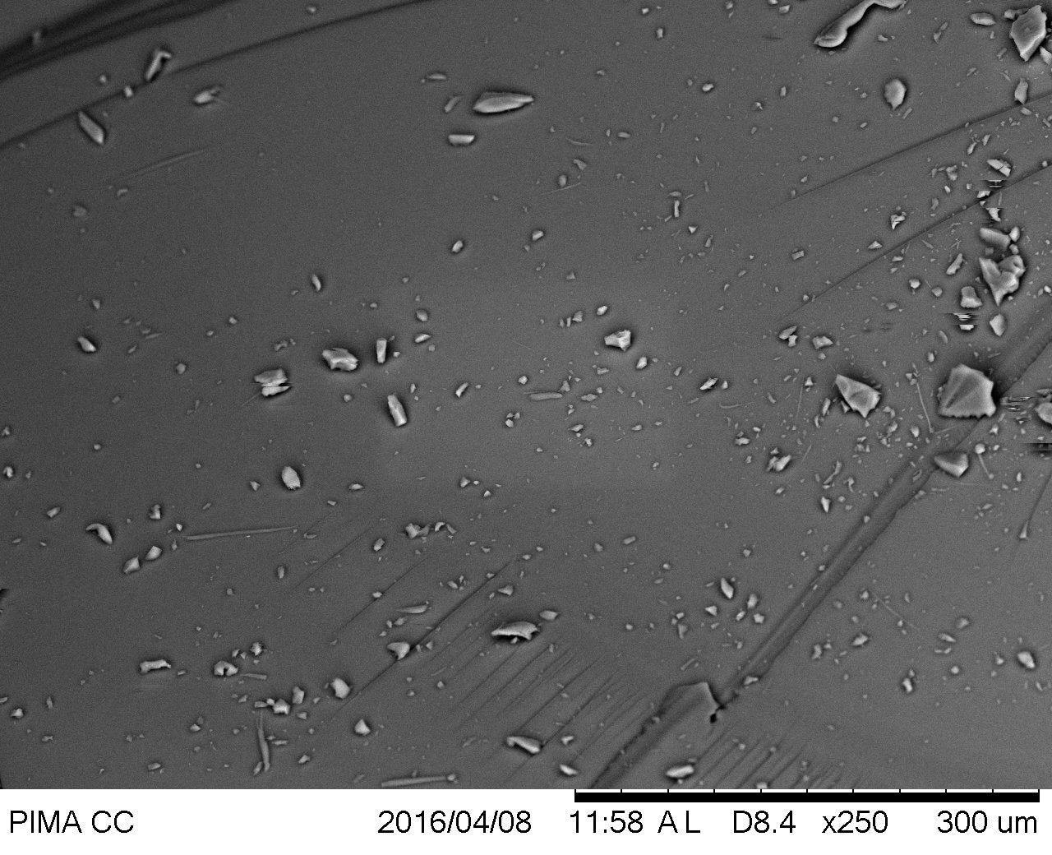
Spring Semester 2016
Launch Results
Upon impact, xerogel samples were contaminated by dirt
Analysis by scanning electron microscopy and energy-dispersive x-ray spectroscopy proved to be futile

Slide 13
Acknowledgements
Tim Swindle - Space Grant Director
Susan Brew - Space Grant Manager
Jack Crabtree - ANSR
Silvia Kolchens - PCC Mentor
ANSR Volunteers
Aerogel.org

Slide 14
Questions?

